Slide 1

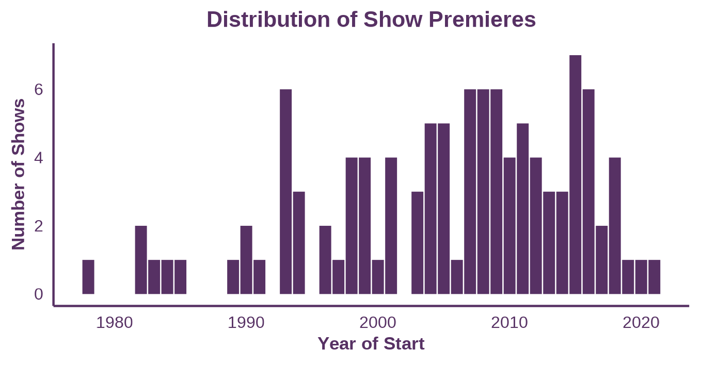
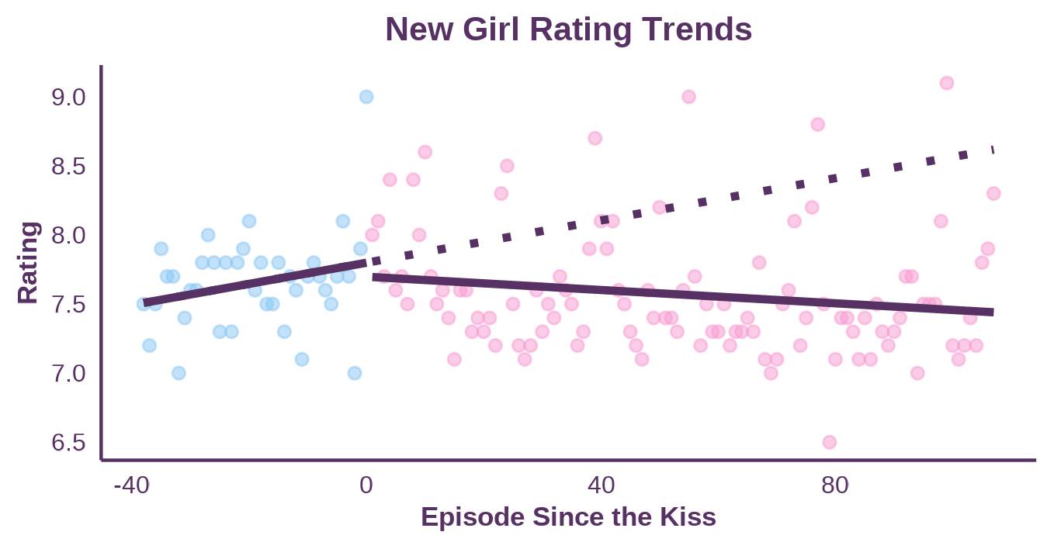
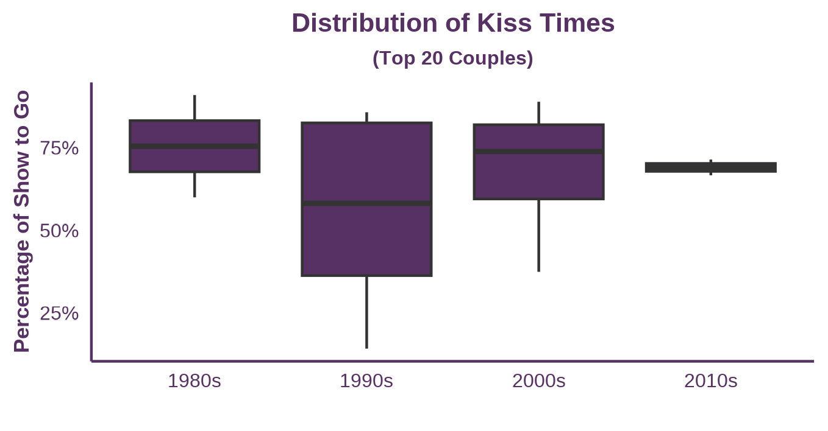
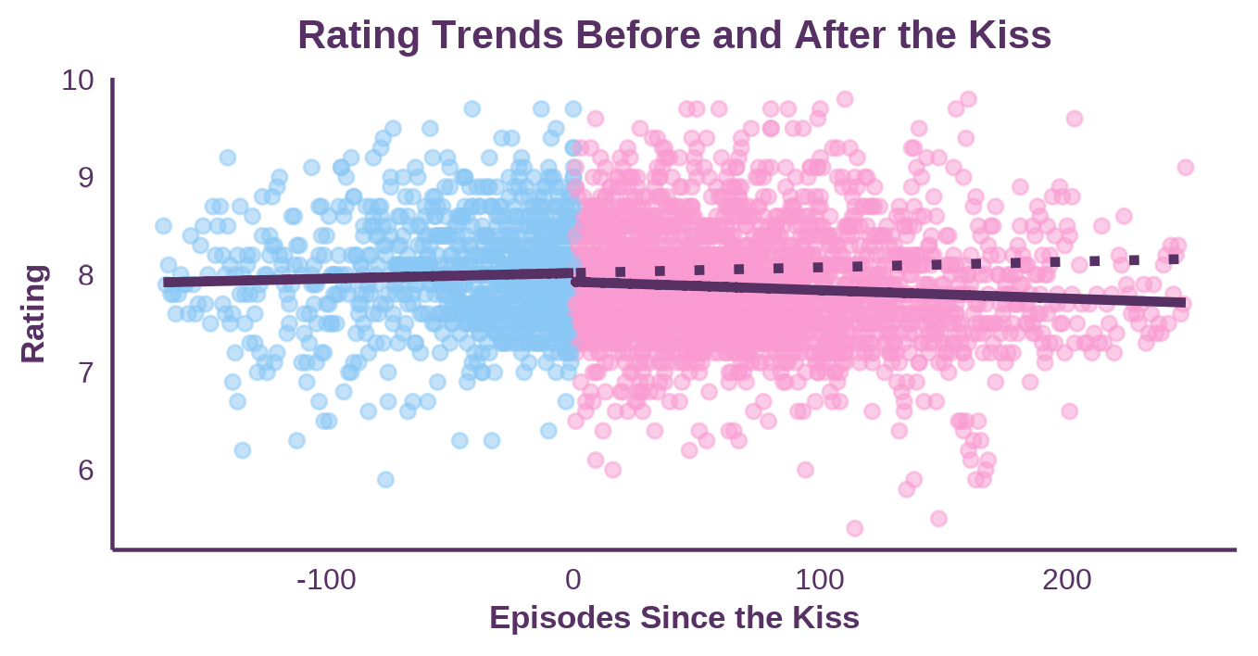
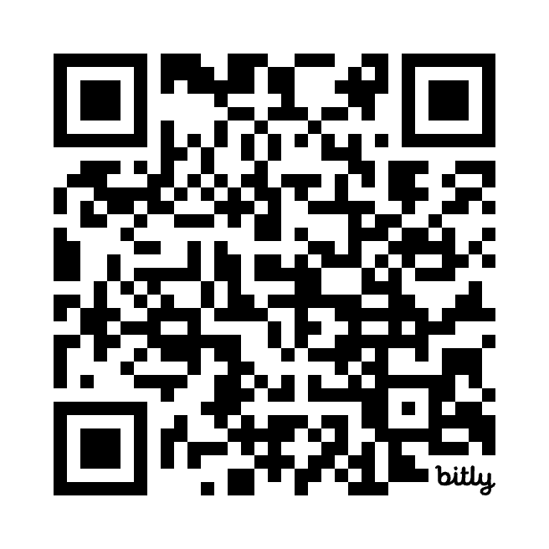
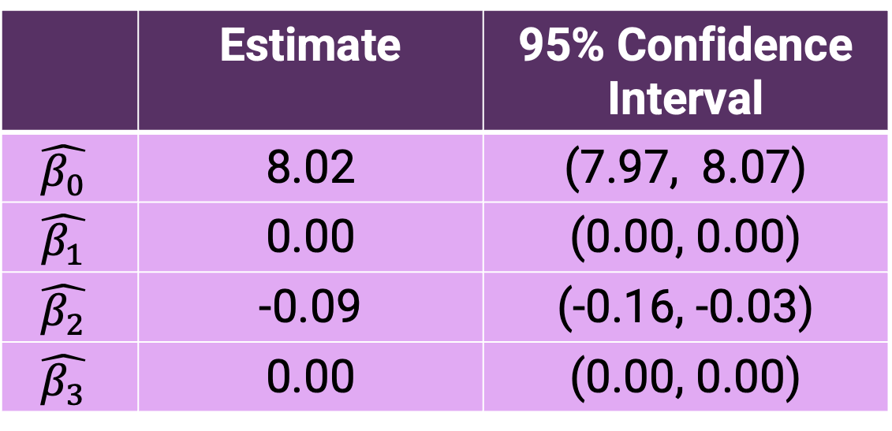
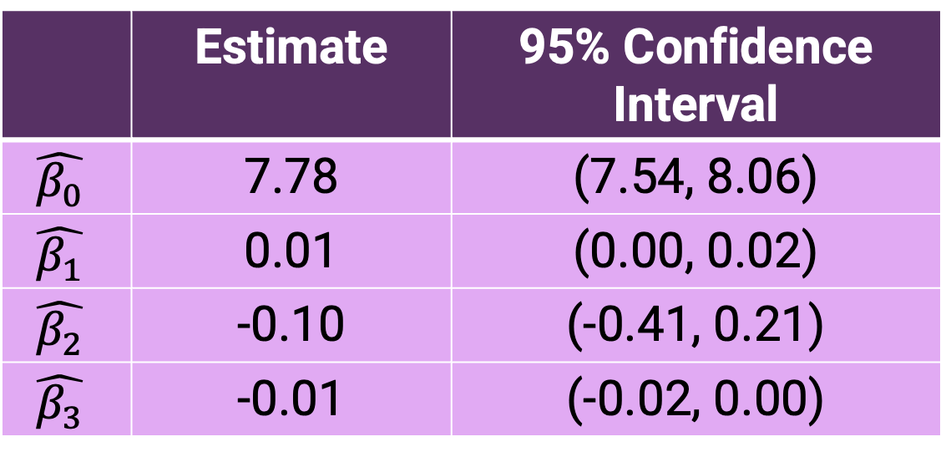
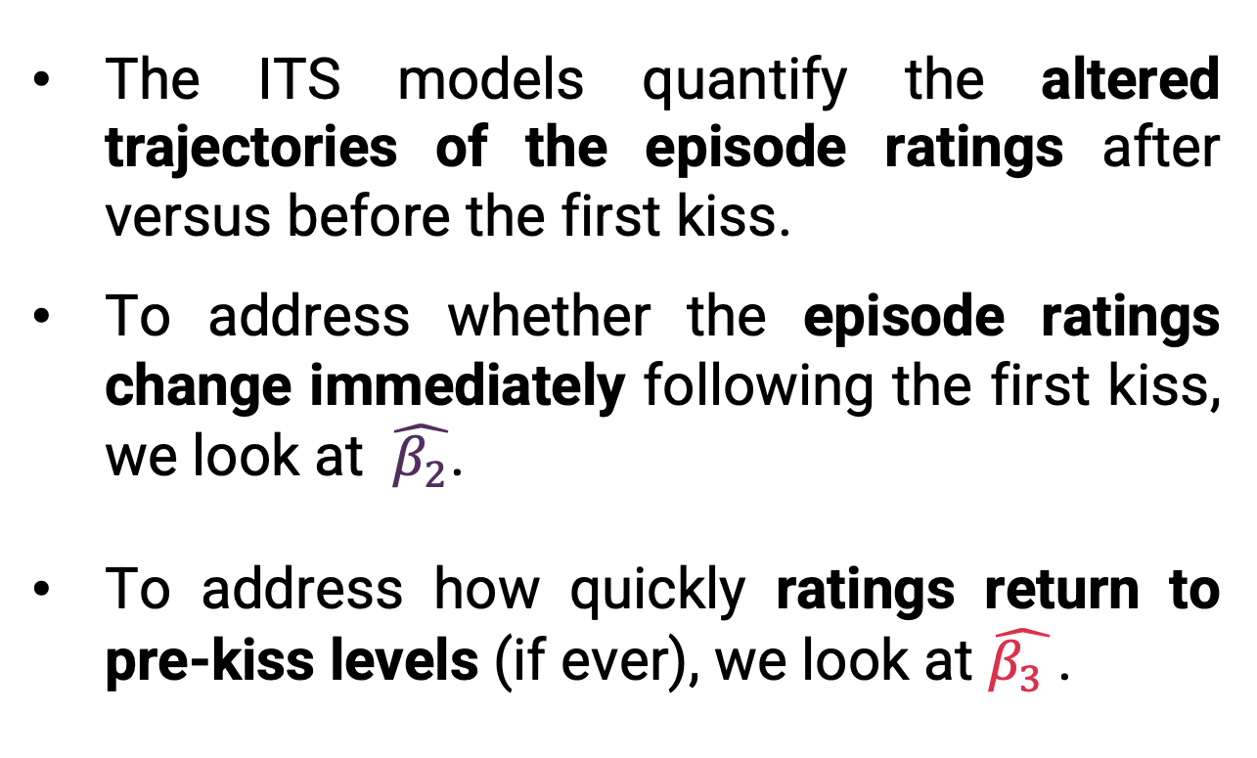

Rate This Interruption: Using Interrupted Time Series Techniques to Analyze Popular Television Couples and Episode Ratings
Ashley E. Mullan, Lucy D’Agostino McGowan, Sarah C. Lotspeich
Department of Statistical Sciences, Wake Forest University, Winston-Salem, North Carolina
INTRODUCTION
RESULTS
Many television (TV) shows follow the “will they or won’t they” trope, where the dynamic between a pair of characters constantly shifts between almost-romance and friendship.
The couple demonstrates romantic chemistry, but their future is plagued by uncertainty and conflict.¹
This trope has persisted throughout the decades, and examples include Sam and Diane from the 1980s show Cheers and Jess and Nick from the 2010s show New Girl.
The audience may wait multiple seasons before the couple gets together; some suspect producers delay it to create suspense and keep viewers engaged.
Events marking major romantic milestones, like the couple’s first kiss, often change the plot trajectory, influence the number of viewers and impact ratings.
Table 1: Show-Specific Model (New Girl)
 | Estimate | 95% Confidence Interval
$$\hat{β_{0}}$$ | 7.78 | (7.54, 8.06)
$$\hat{β_{1}}$$ | 0.01 | (0.00, 0.02)
$$\hat{β_{2}}$$ | -0.10 | (-0.41, 0.21)
$$\hat{β_{3}}$$ | -0.01 | (-0.02, 0.00)
The ITS models quantify the altered trajectories of the episode ratings after versus before the first kiss.
To address whether the episode ratings change immediately following the first kiss, we look at $\hat{β_{2}}$.
To address how quickly ratings return to pre-kiss levels (if ever), we look at $\hat{β_{3} }$.
Figure 1: Distribution of Show Premieres The “will they or won’t they” trope has persisted from as early as the 1980s to today.
Figure 3: ITS Model Results After the first kiss airs, the ratings decrease on average. This trend persists both at the show level (above) and overall (below).
METHODS
Data
Through publicly available rankings, the 20 most-cited “will they or won’t they” TV couples were identified.
Data about couple-show pairings were collected from the Internet Movie Database (IMDb)³ and Wikipedia⁴.
Variables of interest include the timing of the first kiss, the couples’ internet popularity, the number of seasons, the year of premiere, and episode ratings.
Analysis
An interrupted time series (ITS) model was used to examine the impact of a couple’s first kiss (the interruption) on a show’s per-episode $\hat{Rating}=$
$${\hat{β}}_{0}+{\hat{β}}_{1}Episode+{\hat{β}}_{2}AfterKiss+{\hat{β}}_{3}Episode×AfterKiss$$
This model was fit at two levels: 1) show-specific, considering only Jess and Nick from New Girl and 2) all shows, considering all 20 most-cited couples.
Table 2: Overall Model (Top 20 Couples)
 | Estimate | 95% Confidence Interval
$$\hat{β_{0}}$$ | 8.02 | (7.97, 8.07)
$$\hat{β_{1}}$$ | 0.00 | (0.00, 0.00)
$$\hat{β_{2}}$$ | -0.09 | (-0.16, -0.03)
$$\hat{β_{3}}$$ | 0.00 | (0.00, 0.00)
Figure 2: Distribution of Kiss Times Except for those premiering in the 1990s, most shows chose to cut the trope short. The couple from each decade with the median kiss time has their first kiss with over two-thirds of the show left to go.
DISCUSSION AND CONCLUSION
REFERENCES
The top 20 most-cited couples still include couples from the 1980s.
The shows airing in the 1990s had the most variation in when the kisses occurred, while the shows from the other decades tended to have the kisses in similar places.
For both models, we observe an immediate drop in the ratings immediately following the kiss.
For New Girl, the 95% confidence interval for the immediate change does include zero, but the overall model was strictly negative.
The drop in ratings may be due to viewers losing interest after the couple kisses, as the uncertainty tends to disappear in this stage of the plot.
For both models, there was little change to the episode-on-episode ratings trend after the kiss.
However, the confidence intervals are too narrow due to autocorrelation in the episode ratings.
One future direction could be to adjust the standard error estimates to fix the coverage of the intervals.
1. https://en.wiktionary.org/wiki/will-they-won%27t-they
2. https://pubmed.ncbi.nlm.nih.gov/27283160/
3. https://www.imdb.com/
4. https://www.wikipedia.org/
Episode-on-Episode Change Before First Kiss
Difference in After Change Before First Kiss
Immediate Change After First Kiss
Check out the data!
Notes:
How to best cite all the sources. Sentence about them living in the QR code? Which does need to be fixed LOL

Slide 2
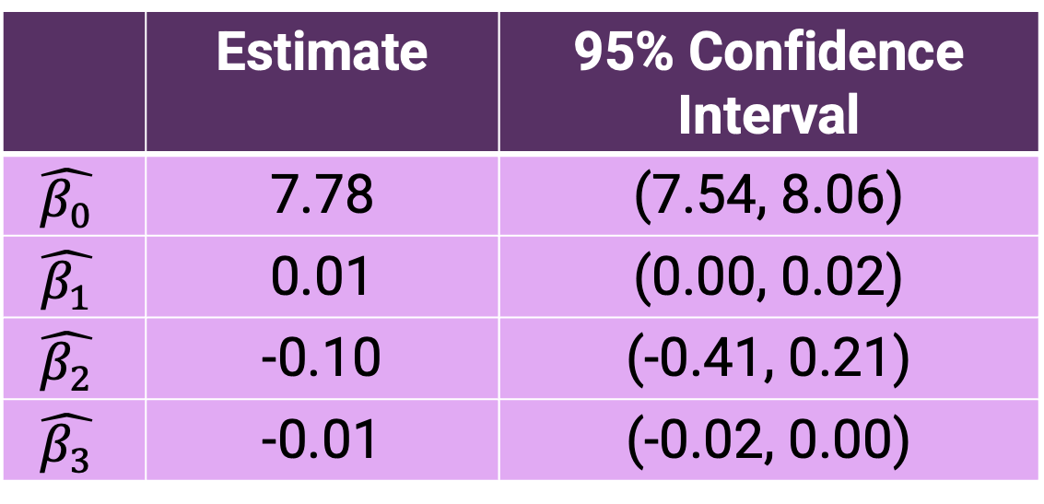

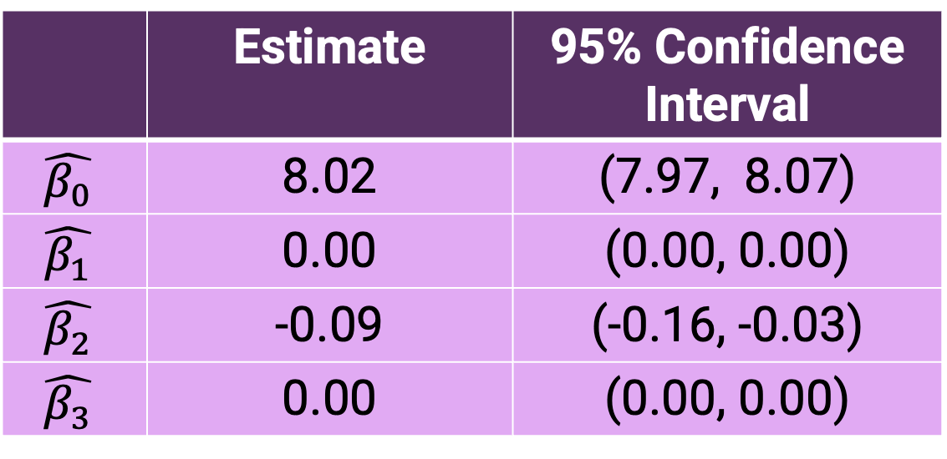
RESULTS
Table 1: Show-Specific Model (New Girl)
 | Estimate | 95% Confidence Interval
$$\hat{β_{0}}$$ | 7.78 | (7.54, 8.06)
$$\hat{β_{1}}$$ | 0.01 | (0.00, 0.02)
$$\hat{β_{2}}$$ | -0.10 | (-0.41, 0.21)
$$\hat{β_{3}}$$ | -0.01 | (-0.02, 0.00)
The ITS models quantify the altered trajectories of the episode ratings after versus before the first kiss.
To address whether the episode ratings change immediately following the first kiss, we look at $\hat{β_{2}}$.
To address how quickly ratings return to pre-kiss levels (if ever), we look at $\hat{β_{3} }$.
Figure 1: Distribution of Show Premieres The “will they or won’t they” trope has persisted from as early as the 1980s to today.
Figure 3: ITS Model Results After the first kiss airs, the ratings decrease on average. This trend persists both at the show level (above) and overall (below).
Table 2: Overall Model (Top 20 Couples)
 | Estimate | 95% Confidence Interval
$$\hat{β_{0}}$$ | 8.02 | (7.97, 8.07)
$$\hat{β_{1}}$$ | 0.00 | (0.00, 0.00)
$$\hat{β_{2}}$$ | -0.09 | (-0.16, -0.03)
$$\hat{β_{3}}$$ | 0.00 | (0.00, 0.00)
Figure 2: Distribution of Kiss Times Except for those premiering in the 1990s, most shows chose to cut the trope short. The couple from each decade with the median kiss time has their first kiss with over two-thirds of the show left to go.
Notes:
How to best cite all the sources. Sentence about them living in the QR code? Which does need to be fixed LOL

